Slide 1
Summary
Mass measurements
Upper bound
20 wt%

Slide 2
Mass Measurements
Calibration
Calibrated mass from HP Calorimeter
2x 4g mass, measures 4.06g, 4.07g, ~1.5% error
H₂O measurements
Accurate, and within instrument errors
 | V (ml) | m (g) | rho (g/ml)
 | 5 | 5.0299 | 1.0060
 | 5 | 4.9846 | 0.9969
 | 5 | 4.9970 | 0.9994
 | 5 | 5.0024 | 1.0005
 | 5 | 4.9913 | 0.9983
mean |  | 5.0010 | 1.0002
sd |  | 0.0174 | 0.0035
range |  | 0.0275 | 0.0077
Pipette error |  | 0.03
 | V (ml) | m (g) | rho (g/ml)
 | 1 | 1.0077 | 1.0077
 | 1 | 0.9951 | 0.9951
 | 1 | 0.9983 | 0.9983
 | 1 | 0.9957 | 0.9957
 | 1 | 0.9963 | 0.9963
mean |  | 0.9986 | 0.9986
sd |  | 0.0052 | 0.0052
range |  | 0.0126 | 0.0126
Pipette error |  | 0.006

Slide 3
Mass Measurements
Calibration
Calibrated mass from HP Calorimeter
2x 4g mass, measures 4.06g, 4.07g, ~1.5% error
H₂O measurements
Accurate, and within instrument errors
Based on H₂O test, mass balance seems calibrated
Masses from HP Calorimeter may be off
JPL has a dedicated team to calibrate instruments / mass balances
An option to send our balance for calibration, if deemed necessary

Slide 4
Mass Measurements
Density
Has been consistent the past week
Rule out evaporative loss:
Bottle has been opened a lot more over the past week than from 12-Sep
Unless it is unlikely evaporative loss via a leak through a closed bottle
Rule out Temperature effects:
From Tillner-Roth & Friend, T change from 273 K to 303 K changes density by ~0.016 g/ml, not 0.1 g/ml
Sep readings unexplained
Date | 12-Sep | 26-Sep | 4-Oct | 6-Oct | 10-Oct
Density (g/ml) | 0.6158 | 0.6765 | 0.7184 | 0.7156 | 0.7292
 |  |  | 0.7092 |  | 0.6925
 |  |  |  |  | 0.7043
 |  |  |  |  | 0.7082
 |  |  |  |  | 0.7133
mean | 0.6158 | 0.6765 | 0.7138 | 0.7156 | 0.7095
sd |  |  | 0.0046 |  | 0.0120
Pipette error | 0.006 | 0.006 | 0.006 | 0.006 | 0.006

Slide 5
Mass Measurements
Density
Thermostat measures 70 F (294 K)
Tillner-Roth & Friend, at 26.9 wt%, density = 0.9036 g/ml
SeaFreeze, at 26.9 wt%, density = 0.9008 g/ml
At 306 K, density ~ 0.895 g/ml.
Essentially, our ~0.71 measurement is still lower than expected
Ruled out mass balance calibration
Ruled out pipette error
Possibly something with the contents within the supply bottle?
I would like to test once more on a separate mass balance
Date | 12-Sep | 26-Sep | 4-Oct | 6-Oct | 10-Oct
Density (g/ml) | 0.6158 | 0.6765 | 0.7184 | 0.7156 | 0.7292
 |  |  | 0.7092 |  | 0.6925
 |  |  |  |  | 0.7043
 |  |  |  |  | 0.7082
 |  |  |  |  | 0.7133
mean | 0.6158 | 0.6765 | 0.7138 | 0.7156 | 0.7095
sd |  |  | 0.0046 |  | 0.0120
Pipette error | 0.006 | 0.006 | 0.006 | 0.006 | 0.006

Slide 6
Mass Measurements
2.84 wt% test
Density difference between 5 ml and 1ml (was not apparent in H₂O test)
Will be testing 5 ml, changing tips again tomorrow
Did a test on Tuesday, measured ~4.75.
 | V (ml) | m (g) | rho (g/ml)
No change in pipette tips | 5 | 4.7913 | 0.9583
 | 5 | 4.7610 | 0.9522
 | 5 | 4.7589 | 0.9518
 | 5 | 4.748 | 0.9496
 | 5 | 4.7548 | 0.9510
 | 5 | 4.7477 | 0.9495
 | 5 | 4.7644 | 0.9529
 | 5 | 4.7722 | 0.9544
 | 5 | 4.7735 | 0.9547
 | 5 | 4.7761 | 0.9552
mean |  | 4.7648 | 0.9530
sd |  | 0.0137 | 0.0027
range |  | 0.0436 | 0.0087
Pipette error |  | 0.03
 | V (ml) | m (g) | rho (g/ml)
Change in pipette tips every solution draw | 5 | 4.7383 | 0.9477
 | 5 | 4.7299 | 0.9460
 | 5 | 4.7347 | 0.9469
 | 5 | 4.7238 | 0.9448
 | 5 | 4.7370 | 0.9474
mean |  | 4.7327 | 0.9465
sd |  | 0.0059 | 0.0012
range |  | 0.0145 | 0.0029
Pipette error |  | 0.03
 | V (ml) | m (g) | rho (g/ml)
Change in pipette tips every solution draw | 1 | 0.9125 | 0.9125
 | 1 | 0.9096 | 0.9096
 | 1 | 0.9228 | 0.9228
 | 1 | 0.9112 | 0.9112
 | 1 | 0.9089 | 0.9089
mean |  | 0.9130 | 0.9130
sd |  | 0.0057 | 0.0057
range |  | 0.0139 | 0.0139
Pipette error |  | 0.006

Slide 7
Mass Measurements
Questions
Why is our measured density of the supply bottle lower than theoretical?
Why is the density of 5 ml solutions greater than 1 ml?

Slide 8
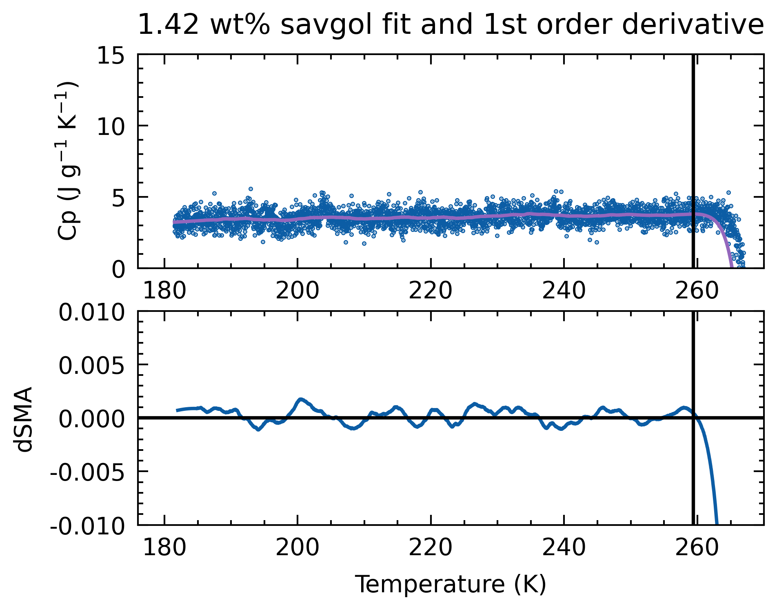
Upper Bound
Previously, bound selection was by eye
Applicable for the lower bound, as peak is sharp
Not for the higher bound
Method:
Apply lower bound cut-off to Cp
Apply Savitsky-Golay Filter to Cp
Obtain derivative of fit
Apply Savitsky-Golay Filter on derivative
Obtain last +ve to –ve crossover point

Slide 9
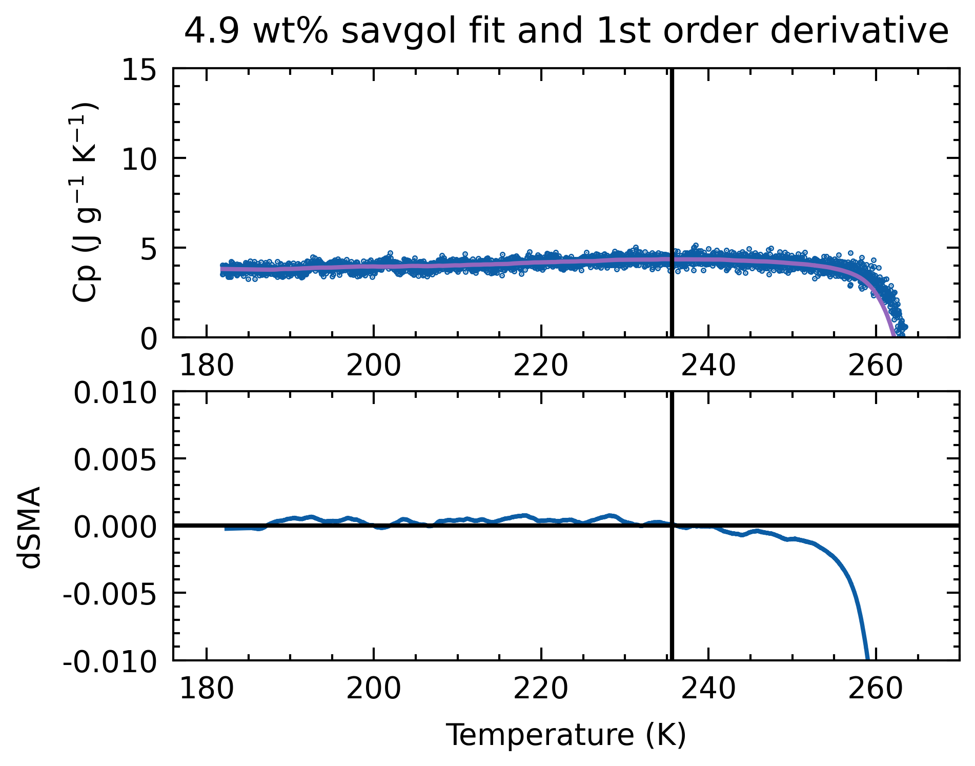
Upper Bound
Method (Savgol-derivative cut)
For sharp drop-offs, works pretty well
For gentle drop-offs, cuts data earlier

Slide 10
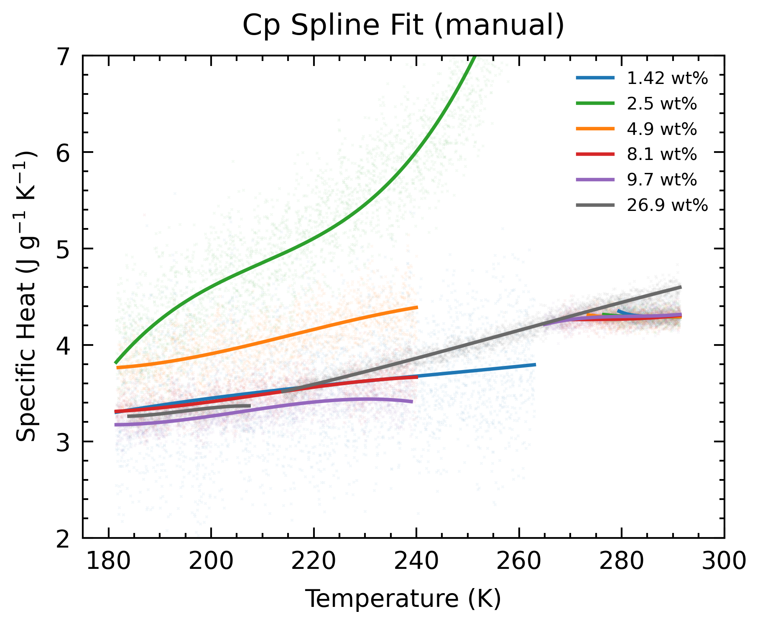
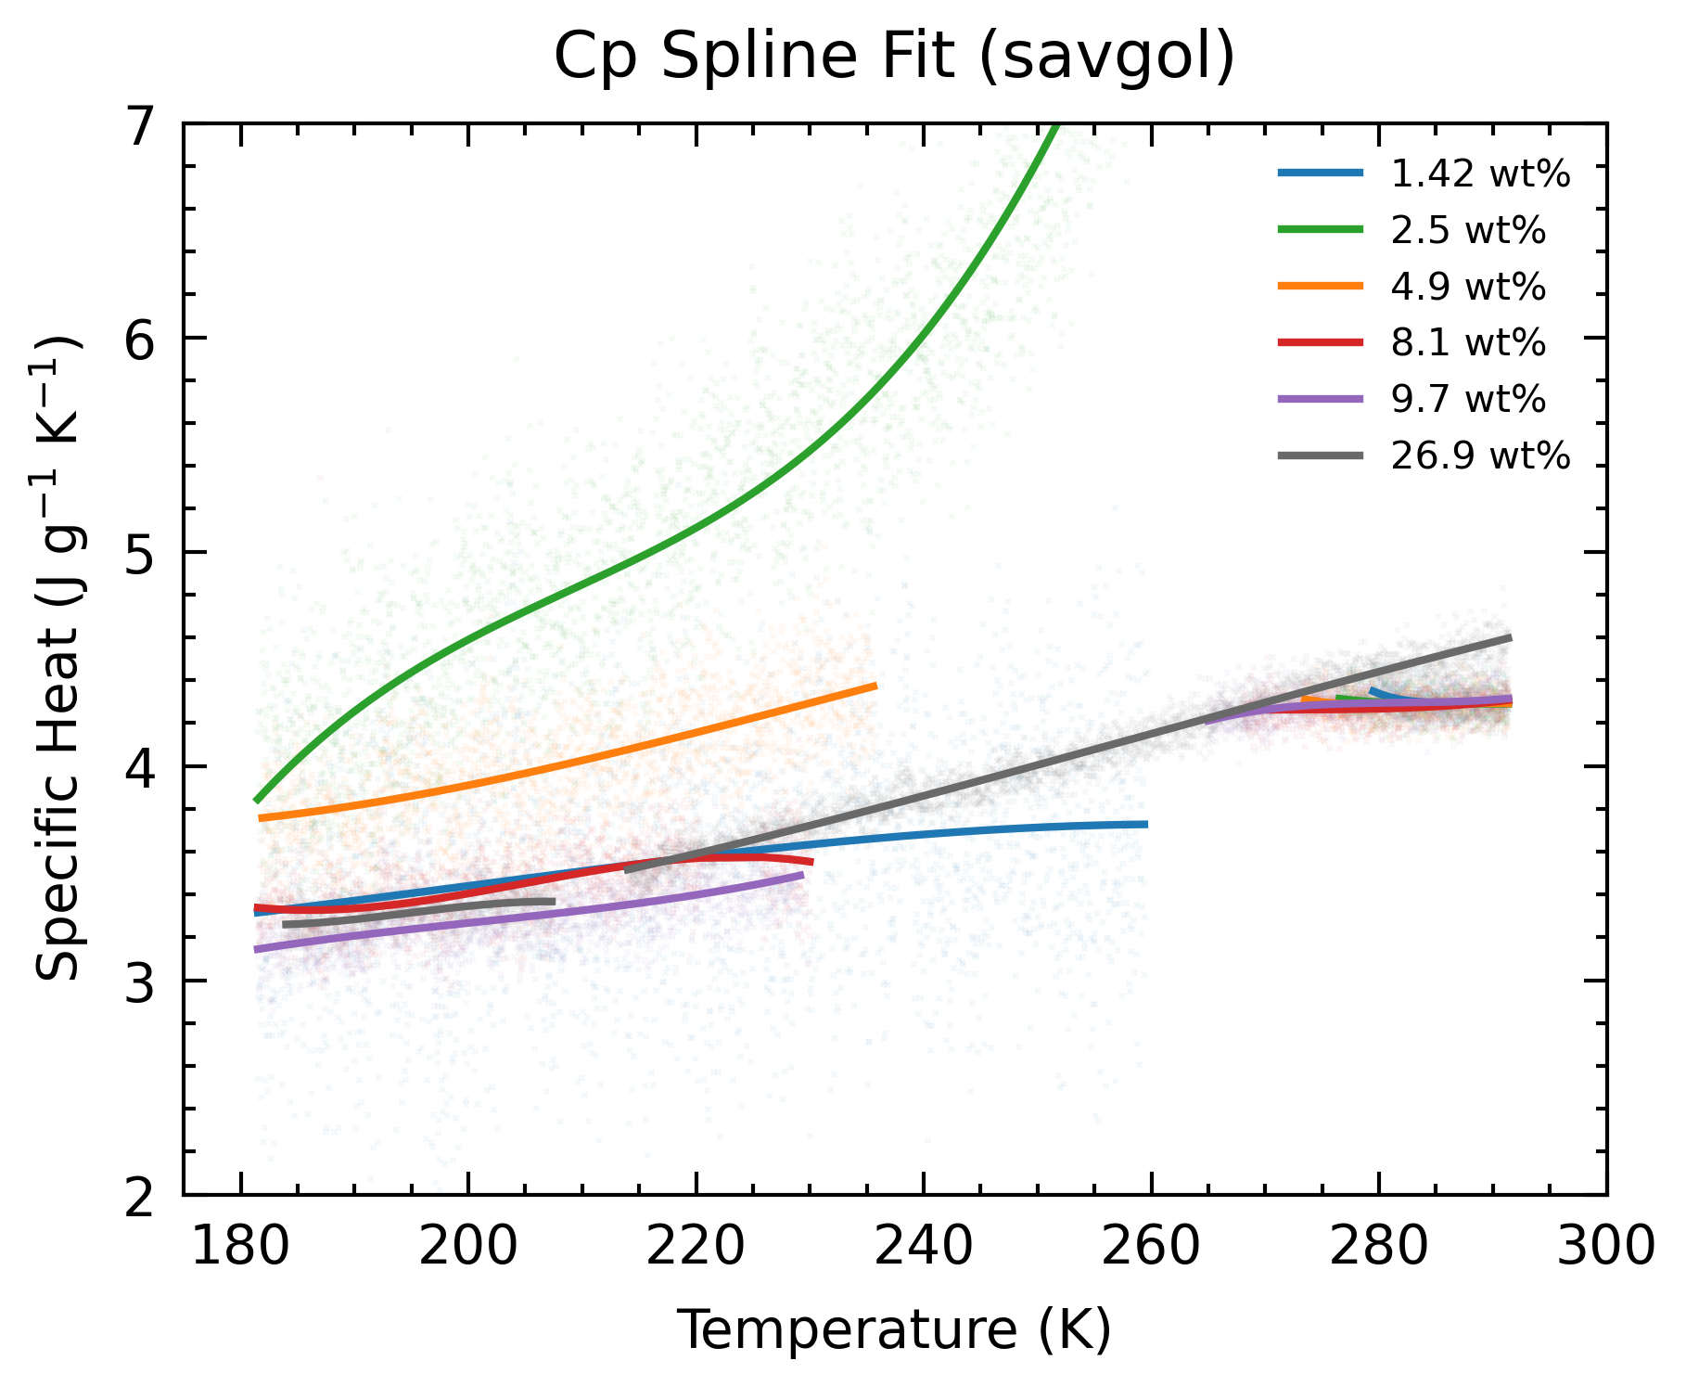
Upper Bound
Method (Savgol-derivative cut)
Verdict: not much change in spline, reduced data range.
Still, at least the bound selection is systematic

Slide 11
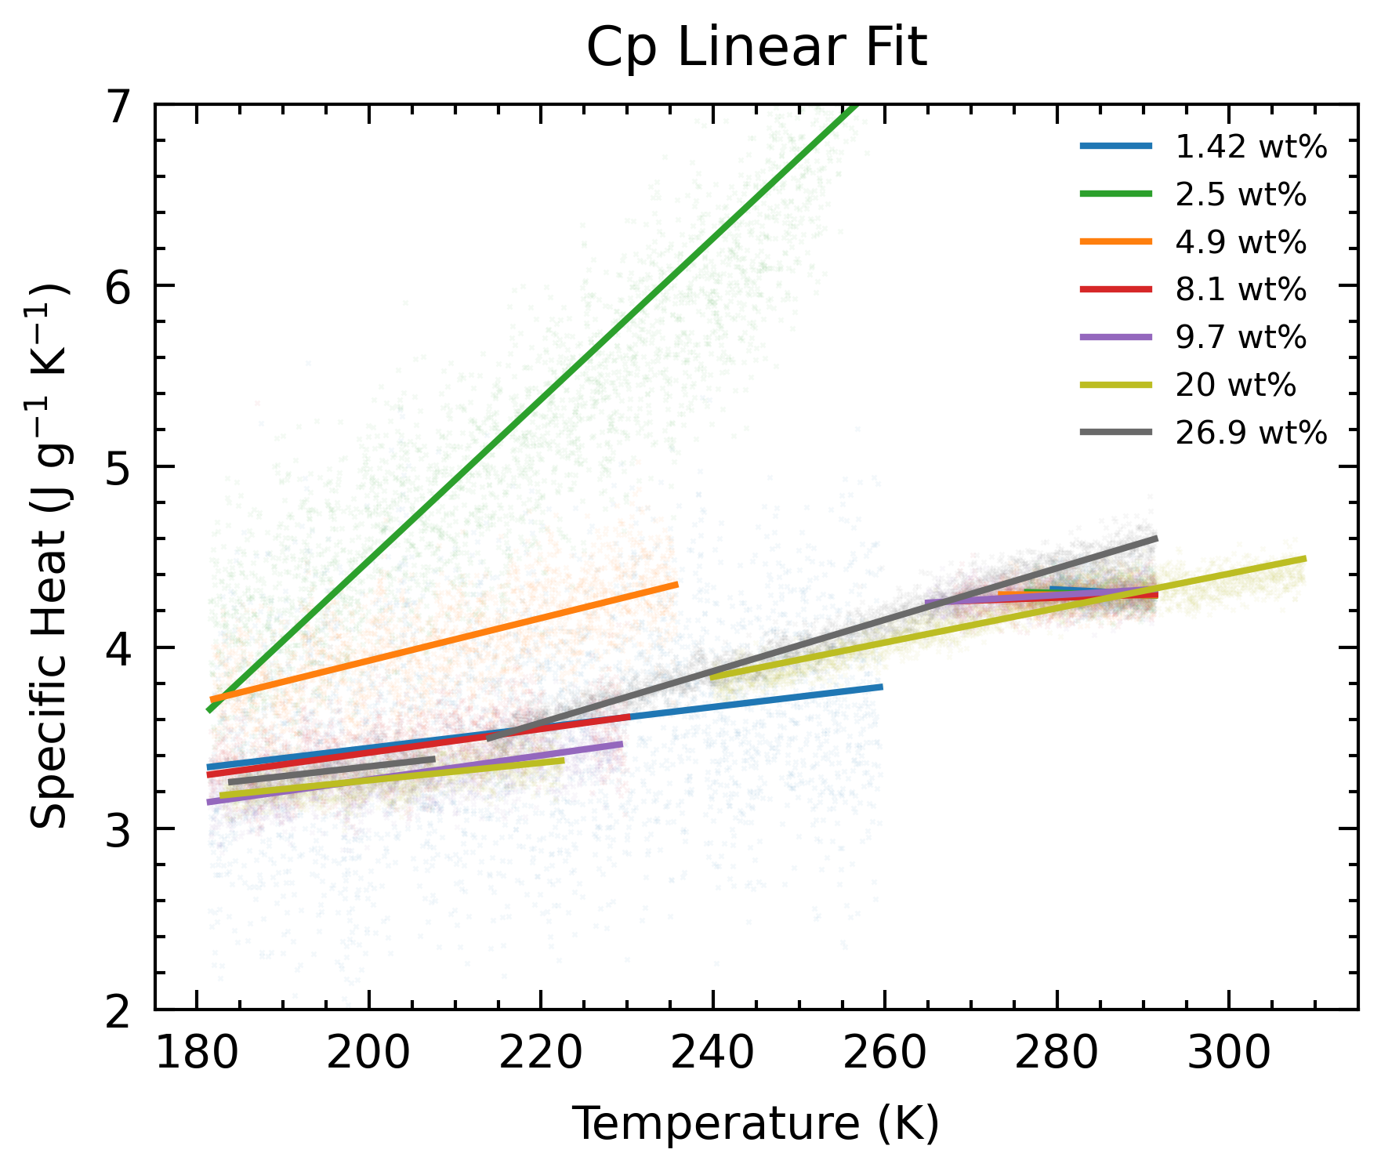
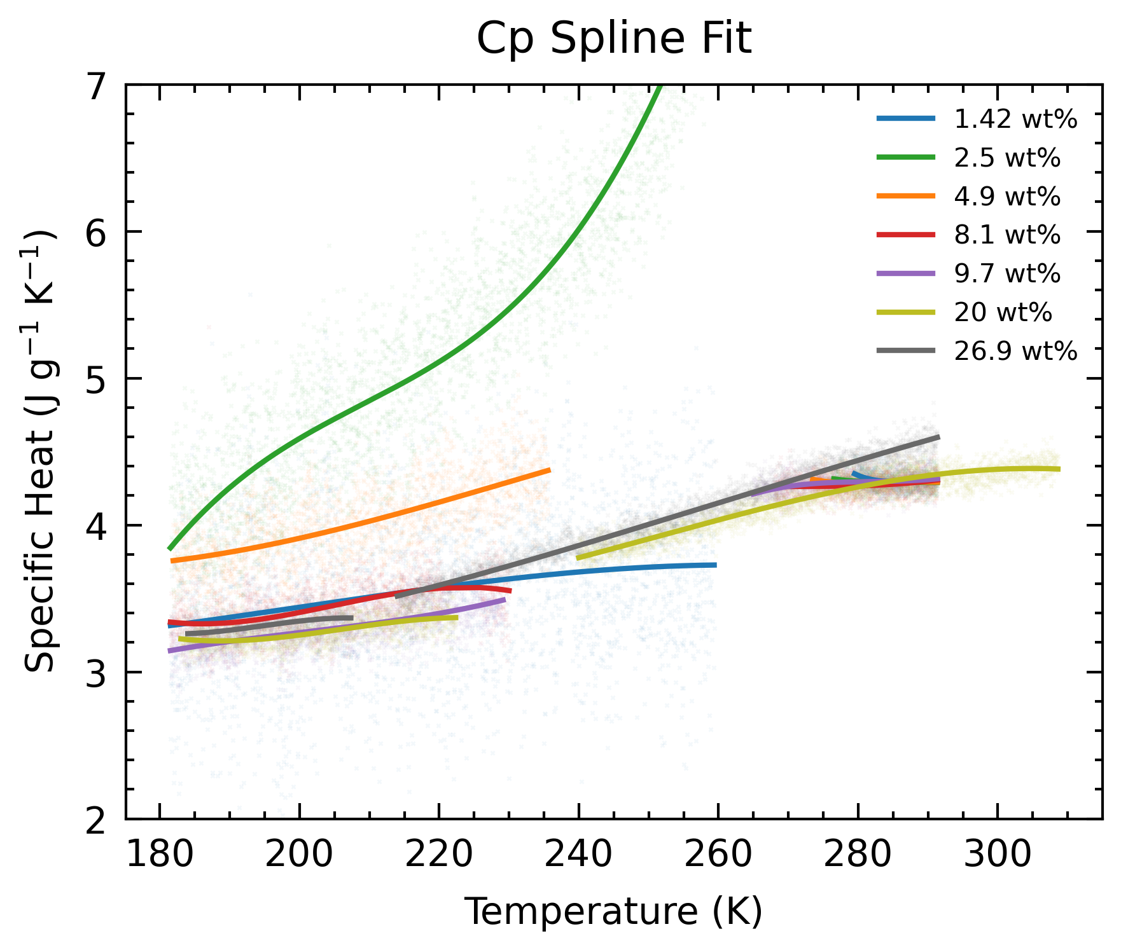
20 wt%
Interesting note:
Lab measurements gave 20 wt%, liquidus alignment gave 20 wt%.
Melt phase aligns with majority

Slide 12
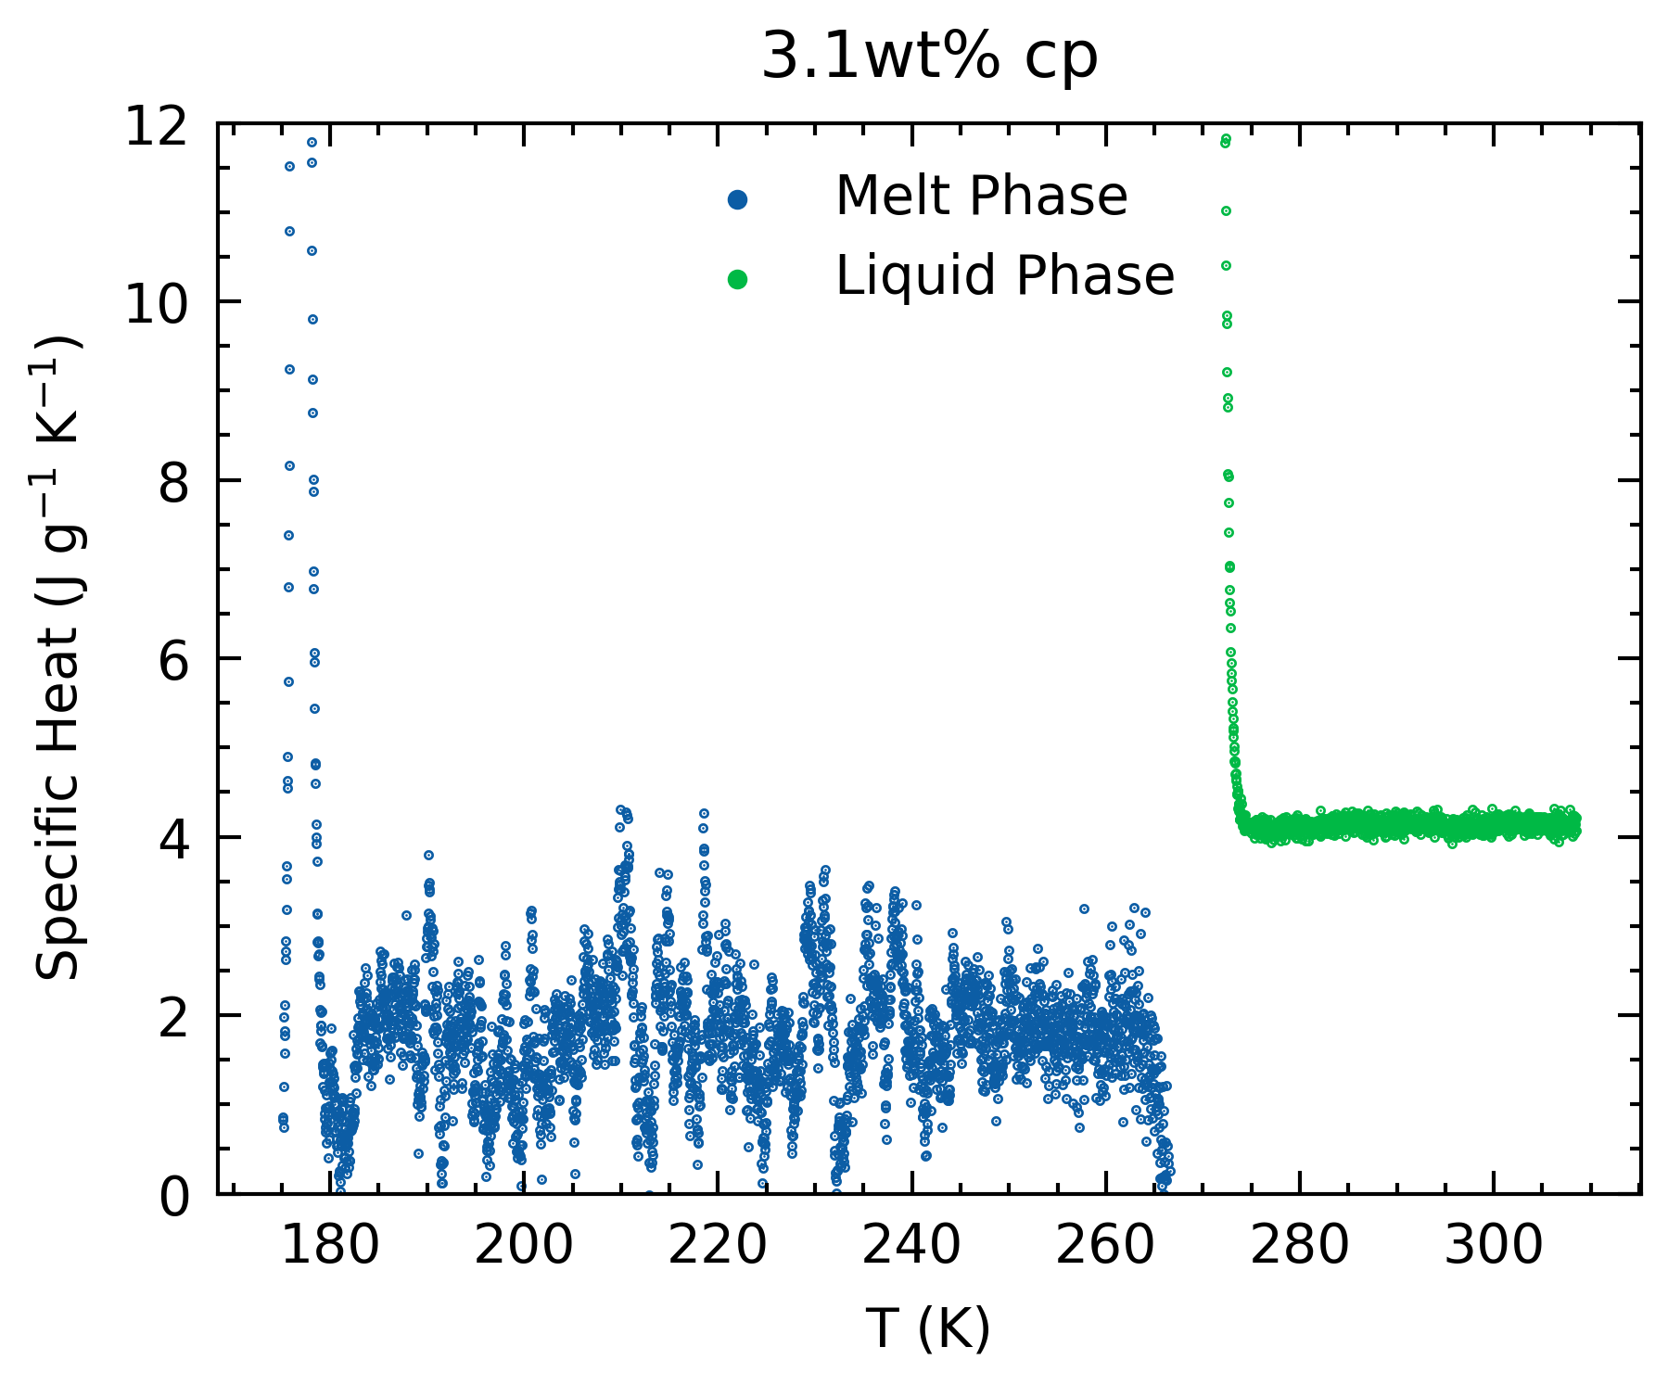
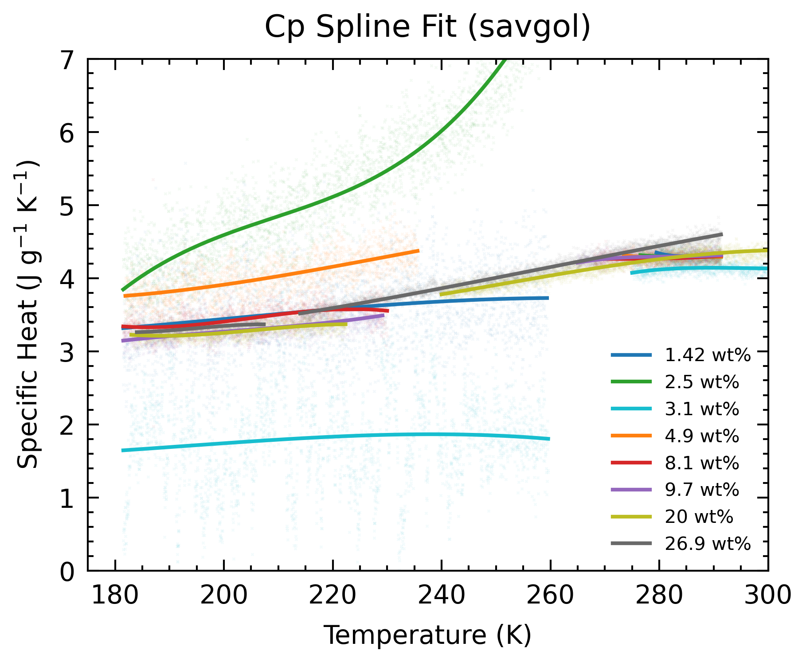
20 wt%
3.1 wt%, 1 ml, small heat flow
Lab measurements gave 2.85 wt%
Lower, for both melt and pure

Slide 13
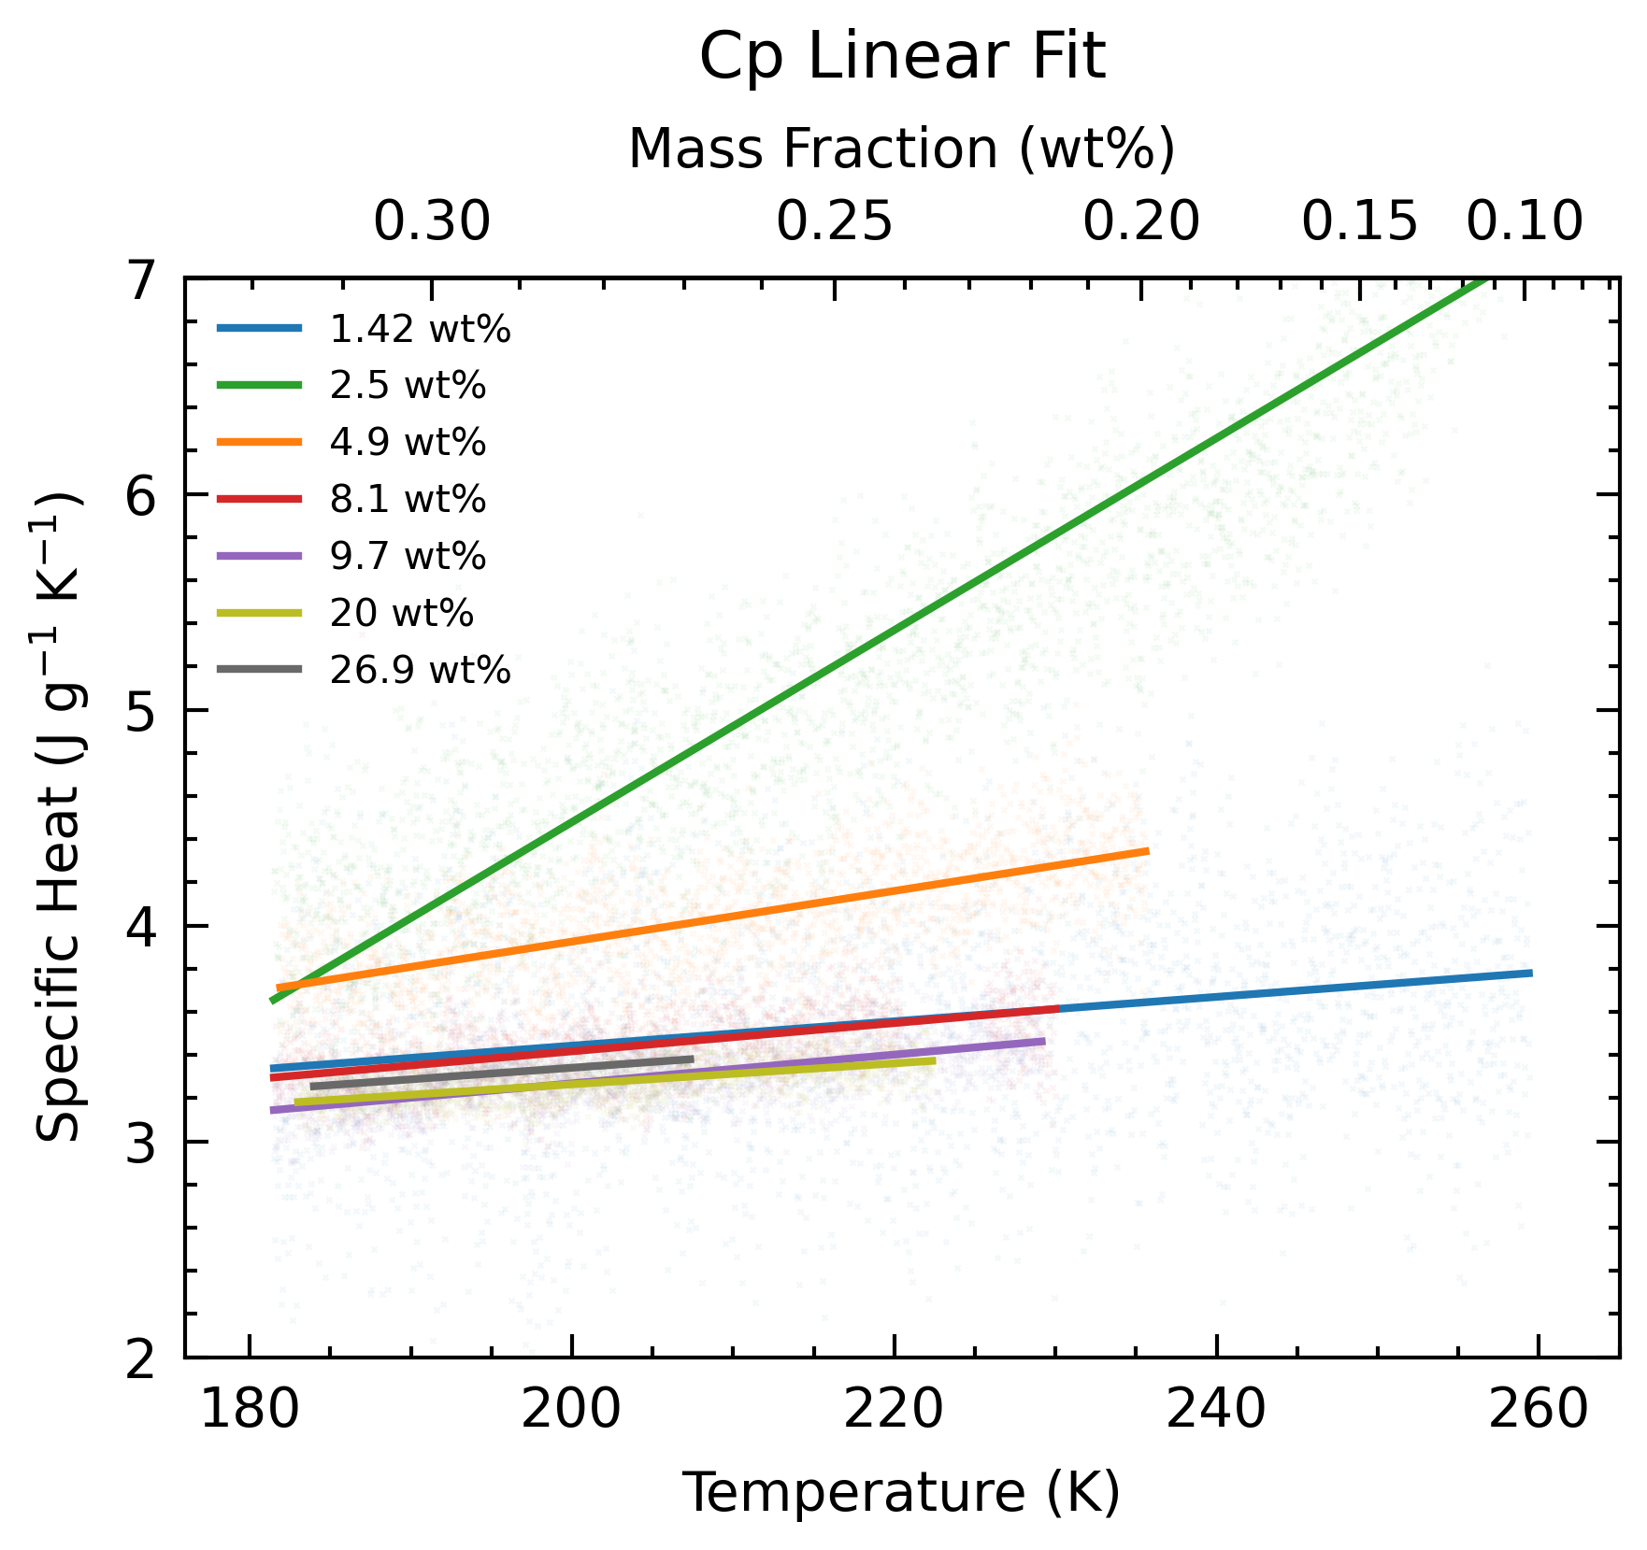
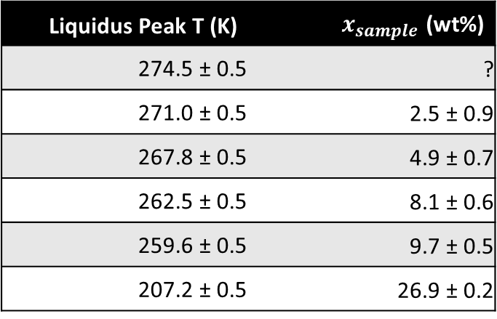
Uncertainties
From liquidus alignment method for determining wt%, low wt%, high errors.
Since in melt phase, all measurements are of the same T-wt% composition,
Higher wt% samples → lower errors
Lower wt% samples → more data at higher temperatures (230-260 K region) K)
Liquidus Peak T (K) | $x_{sample}$ (wt%)
274.5 ± 0.5 | ?
271.0 ± 0.5 | 2.5 ± 0.9
267.8 ± 0.5 | 4.9 ± 0.7
262.5 ± 0.5 | 8.1 ± 0.6
259.6 ± 0.5 | 9.7 ± 0.5
207.2 ± 0.5 | 26.9 ± 0.2

Slide 14
Plan Forward
Using liquidus alignment method and savgol-derivative cut-off, majority of samples seem to align and give a consistent Cp in melt phase.
Moving forward, aim to redo anomalous experiments
Oct 11-14: 15 wt%
Oct 17-20: “1.42” / 2 wt% (due to liquidus peak >273 K)
Oct 24-27: “2.84” / 4 wt% (due to wild Cp values)
Oct 28-31: “5.11” / 6 wt% (due to higher than normal Cp)
Simultaneously, work with Marshall on incorporating current SeaFreeze NH3 EOS into PlanetProfile
Think of method to combine all (non-anomalous) melt phase data into one fit, and associated uncertainty (weighted average fit)

Slide 15
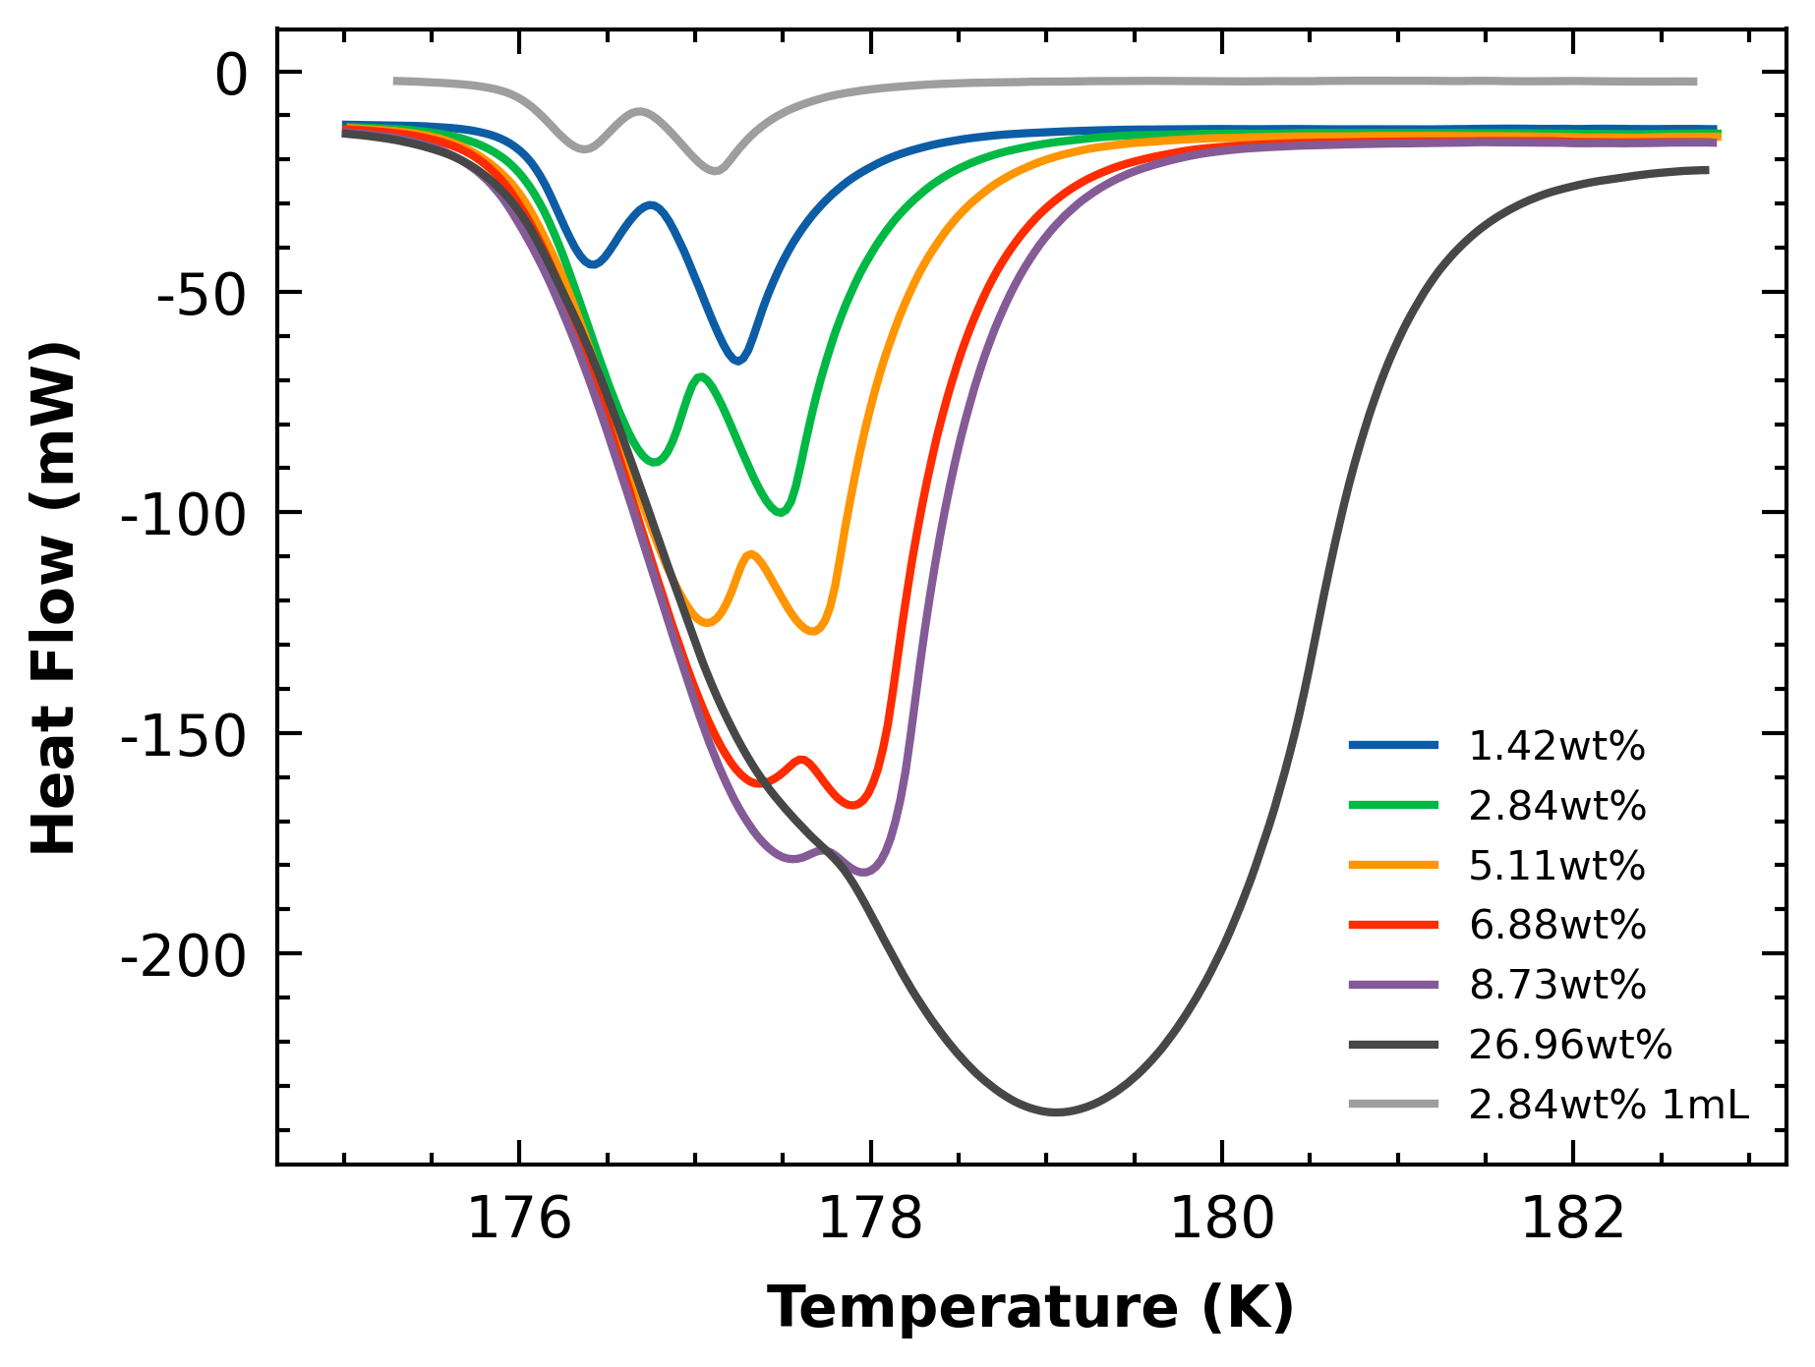
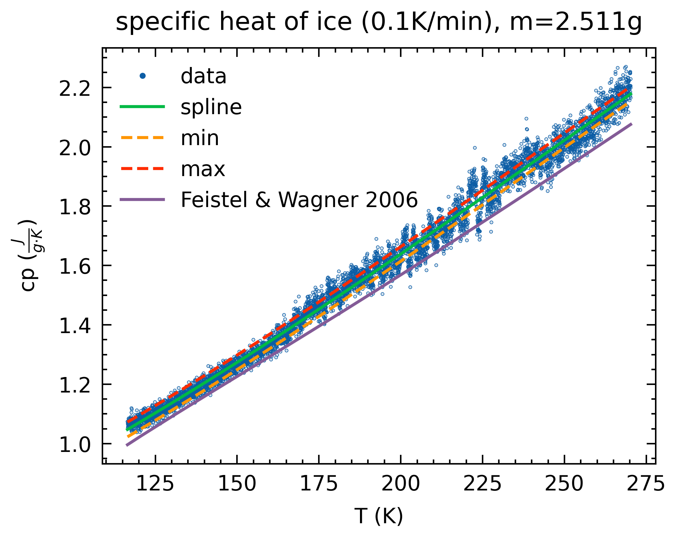
Unanswered Questions
Affects Cp results:
Ice Cp being lower than literature
Density measurements being lower than lit
Does not affect Cp results:
ADH double peaks

